Slide 1
Compression Safety
"Extending the Use of Inference in Temporal Planning as Forwards Search." A. J. Coles, A. I. Coles, M. Fox, and D. Long. Proceedings of ICAPS 2009.

Slide 2
Search space size
Each durative action = two plan steps
Search space at least twice as big
Can we do anything about this?

Slide 3
Why did we start this action?
(:durative-action LOAD-TRUCK
:parameters
(?obj – obj ?truck – truck ?loc - location)
:duration (= ?duration 2)
:condition
(and (over all (at ?truck ?loc))
(at start (at ?obj ?loc)))
:effect
(and (at start (not (at ?obj ?loc)))
(at end (in ?obj ?truck))))

Slide 4
Why did we start this action?
(:durative-action open-barrier
:parameters
(?loc – location ?p - person)
:duration (= ?duration 1)
:condition
(and (at start (at ?loc ?p)))
:effect
(and (at start (barrier-open ?loc))
(at end (not (barrier-open ?loc))))

Slide 5
Compression Safety
In general once the action Cⱶ has been applied, C⊣ will be considered for application in every state in which its preconditions are satisfied.
But our intuition is that if the end of the action does nothing bad, we may as well end it straight away.
Trucks arriving at locations = yay
The barrier coming back down = nope
Formally?

Slide 6
The end-effect rule
There must be no end-delete effects
Delete effects make preconditions false, which is bad:
  if we immediately add C⊣ after Cⱶ in this case, then we might not be able to use a fact that C added, e.g. the match domain.

Slide 7
The end-precondition rule
If an action has end-preconditions that aren't also over all conditions, we can't just end it – maybe we have to do something first.
C requires p, adds q. D requires q, adds r. C⊣ requires r.
pre (C⊣) might not be satisfied.
p
q
r
A
C
D
C
q
r

Slide 8
Compression Safe End Preconditions
In general once the start of an action (Cⱶ) has been applied Invariants of C will be maintained until C⊣ is applied (no action may be applied that violates them).
If pre (C⊣) ⊆ Pre(C↔), C⊣ is always applicable so we don’t need to worry about something deleting pre (C⊣).

Slide 9
Putting it together
An action is compression safe if:
  It has no end delete effects;
  and no end preconditions that are not over all conditions.
In general once the start of an action (Cⱶ) has been applied its end (C⊣) will be considered in every possible state (in which its end preconditions are satisfied) until it has been applied.
But if the action is compression safe we can just add both the start and end of the action to the plan at the same time.

Slide 10
What about quality?
Two actions J and K, totally independent
Most efficient plan:
But if we end them as soon as they start?
A
J
K
J
K
A
J
J
K
K

Slide 11
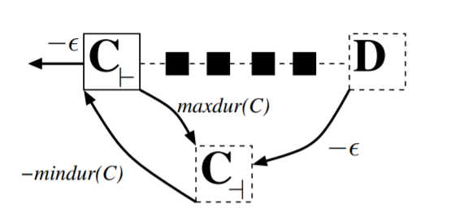
POPF Does it for us!
If we 'automatically' end a compression safe action, that adds a fact p (recall this action does not delete anything)?
  Only future actions that use or delete p must come after the action.
  POPF will do this anyway

Slide 12
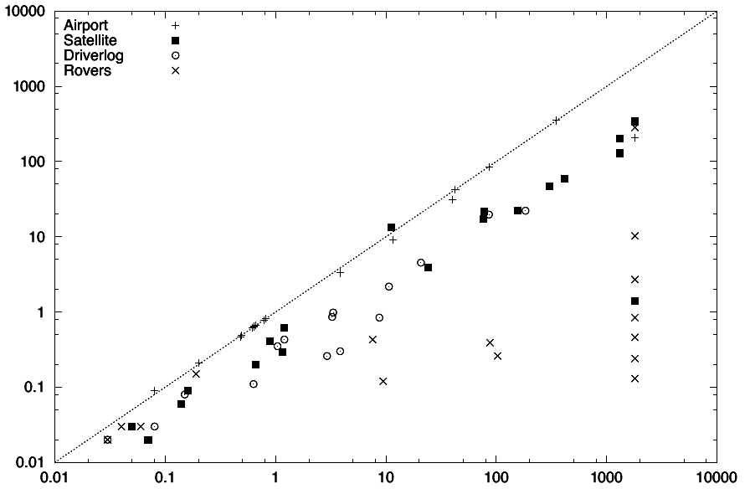
So what?
Exploiting Compression Safety
(automatically ending actions)
Starting and Ending Actions Individually (Time in seconds)

